Slide 1


Slide 2
FINAL YEAR PROJECT PRESENTATION Fire Fighter Robot
Registration No: Name:
CIIT/SP16-MCS-003/SWL H.M Asim Fayyaz
CIIT/SP16-MCS-005/SWL M. Bilal Afzal
CIIT/SP16-MCS-011/SWL M. Asad Saleem
CIIT/SP16-MCS-012/SWL Shaheer Khan
Supervised by:
Mr. Muhammad Ahmad

Slide 3
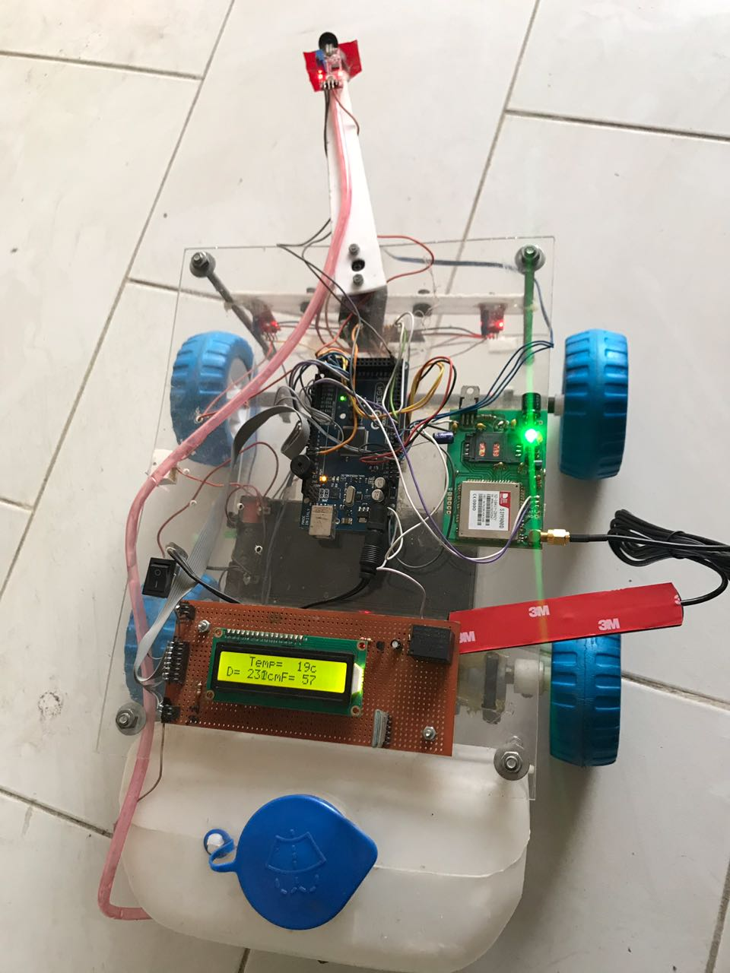
Fire Fighter
Robot

Slide 4
Outline
Background
Introduction
Objectives
Scope
Component
Design
Flowchart
Components Quantity
Conclusion
Future extensions

Slide 5
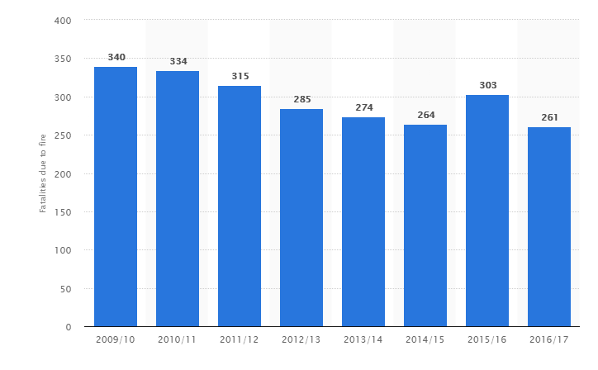
Background
Historical view of fatalities in Pakistan due to fire.

Slide 6
What is fire fighter robot?
An anti fire robot that extinguish the fire.
It works automatically as well as manually via Android App to detect the flames of fire.
This is movement based robot. It used to sense the fire and spreads the water over that direction.

Slide 7
Why fire fighter robot?
Fire accidents happens in Power plants, Buildings, Schools, Colleges, Shopping malls etc.
Possibility of Heavy damage to human beings due to fire accidents.
The elimination of fire before it spread away will avoid the catastrophic effects.
A good replacement of fireman in dangerous places.

Slide 8
Objective
Use an algorithm and android app to turn Fire Fighter Robot manually or automatically.
Completely inform about the situation of place where fire burns via GSM.
Prevent hurdles or obstacles in the way to desired location.
Extinguish fire.

Slide 9
Scope
Design a fire fighter robot using AI approach.
Apply the algorithm to achieve maximum benefits from it.
Save human beings from catastrophic effects
The System being developed is Purely for Safety of human beings and their belongings.

Slide 10
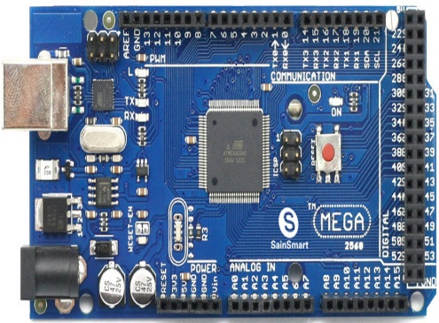
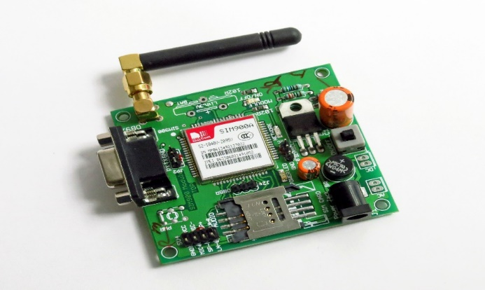
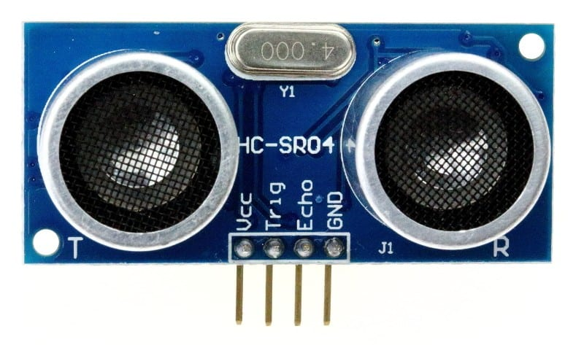
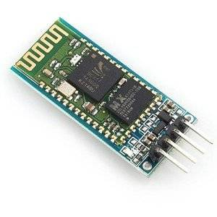
Components
Arduino mega
GSM
Ultrasonic Sensor
Bluetooth

Slide 11
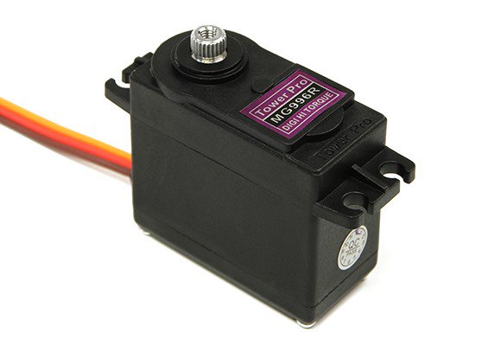
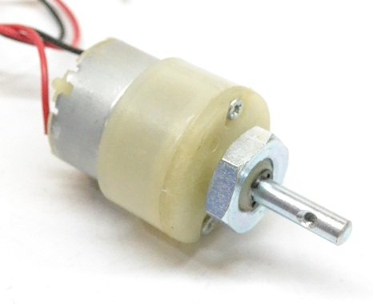
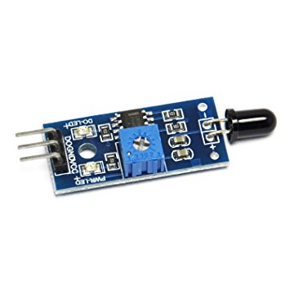
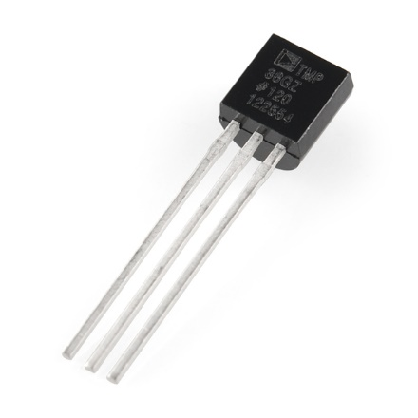
Components
Dc gear motor
Servo motor
Flame sensor
Temperature sensor

Slide 12
Design:
Steps of building the module
Movement step.
Flame tracking step.
Message sending step to authorized person.
Extinguishing Fire step.

Slide 13
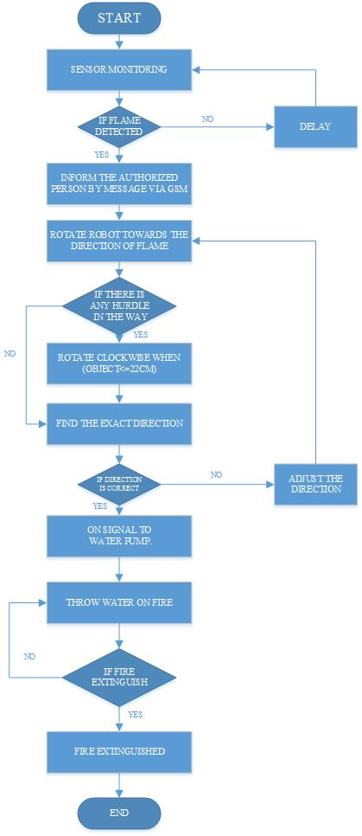
Flow Chart:

Slide 14
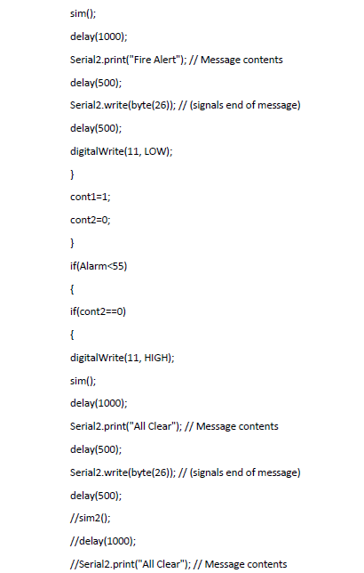
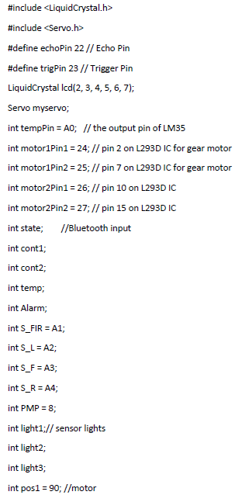
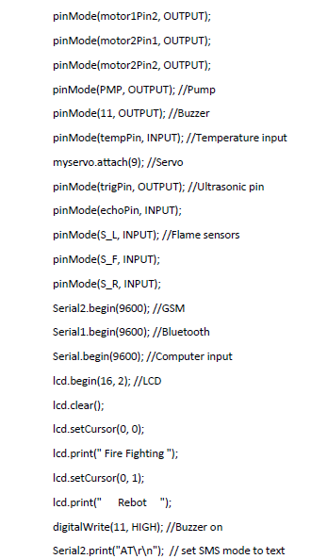
Code:
GSM Function
Pins Mode
Initialization
LCD output

Slide 15
Proposed Model

Slide 16
Components Quantity
Component name | Quantity
Flame sensor | 4
Ultrasonic sensor Hcsr04 | 1
Arduino mega 2560 | 1
GSM Sim 900d | 1
Water pump | 1
Temperature sensor LM35 | 1
Servo motor mg996r | 1
Dc gear motor 100rpm | 2
Motor driver L298 | 1
Bluetooth module HC-05 | 1

Slide 17
Conclusion
Aim to reduce the effect of fires accidents.
The robot can successfully find fire and reach it.
We managed to construct the robot comfortably and user friendly within the affordable cost.

Slide 18
Future extension
In future to perform versatile tasks following amendments can be made
Laser sensors for high range distance detection
Flame sensors for high range flame detection
IOT based
Detection of human movement by using PIR.

Slide 19


